Slide 1



Finance Performance Summary
SALES | PROFIT | FINANCIAL PERFORMANCE
118.73M in sales and 16.89M in profit, with a strong finish in Q4.
Notes:
Summary of the Finance Performance Dashboard: sales, profit and units sold, broken down by segment, product and quarter.

Slide 2
Headline numbers
TOTAL SALES
GROSS SALES
118.73M
127.93M
9.2M lower than gross sales
The starting point before the 9.2M gap
TOTAL PROFIT
UNITS SOLD
16.89M
1,125,806
About 14.2% of total sales
About 105 in sales per unit
Notes:
Total sales 118.73M, gross sales 127.93M, profit 16.89M, units sold 1,125,806. Profit margin and sales per unit are calculated from these four figures.

Slide 3
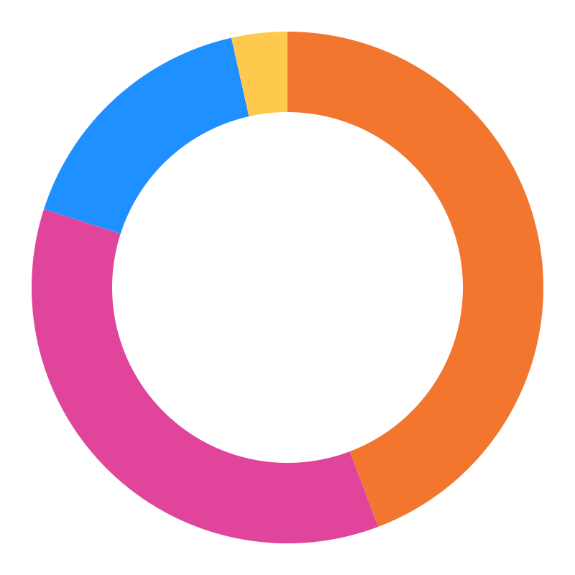
Sales by segment
Government
52.5M · 44.2%
Small Business
42.4M · 35.7%
118.73M
total sales
Enterprise
19.6M · 16.5%
Midmarket + Channel Partners
~4.2M · ~3.5%
Notes:
Government and Small Business together bring in about 80% of sales. Midmarket and Channel Partners are very small slices, shown here combined.

Slide 4
Sales by product
Paseo alone drives about 28% of total sales.
Paseo
~33.0M
VTT
~20.5M
Velo
~18.3M
Amarilla
~17.8M
Montana
~15.4M
Carretera
~13.8M
Product values are read from the dashboard chart, so they are approximate.
Notes:
Paseo leads clearly. VTT, Velo and Amarilla sit close together in the middle, while Montana and Carretera are the smallest.

Slide 5
Profit by quarter
~7.6M
~3.3M
~3.5M
2.2×
~2.7M
Q4 profit compared with Q3
Q4 alone is about 45% of the profit across the four quarters.
Q1
Q2
Q3
Q4
Quarterly values are read from the dashboard line chart, so they are approximate.
Notes:
Profit grows slowly from Q1 to Q3, then jumps sharply in Q4. The 16.89M total on the dashboard is the sum across the four quarters.

Slide 6
Key takeaways
~28%
~80%
of sales come from Paseo, the top product.
of sales come from just two segments: Government and Small Business.
2.2×
~14%
Q4 profit versus Q3, a sharp year-end jump.
profit margin on total sales (16.89M of 118.73M).
Notes:
All four figures are calculated from the dashboard numbers. Product and quarter values are approximate because they were read from charts.

Slide 7
Where to focus next
SUGGESTED NEXT STEPS
1
Keep Paseo strong and lift Montana and Carretera.
2
Grow Enterprise and Midmarket so sales rely on more than two segments.
3
Find out what drove the Q4 jump and repeat it in earlier quarters.
Notes:
These next steps are suggestions drawn from the dashboard patterns, not figures from the data itself.

